Slide 1
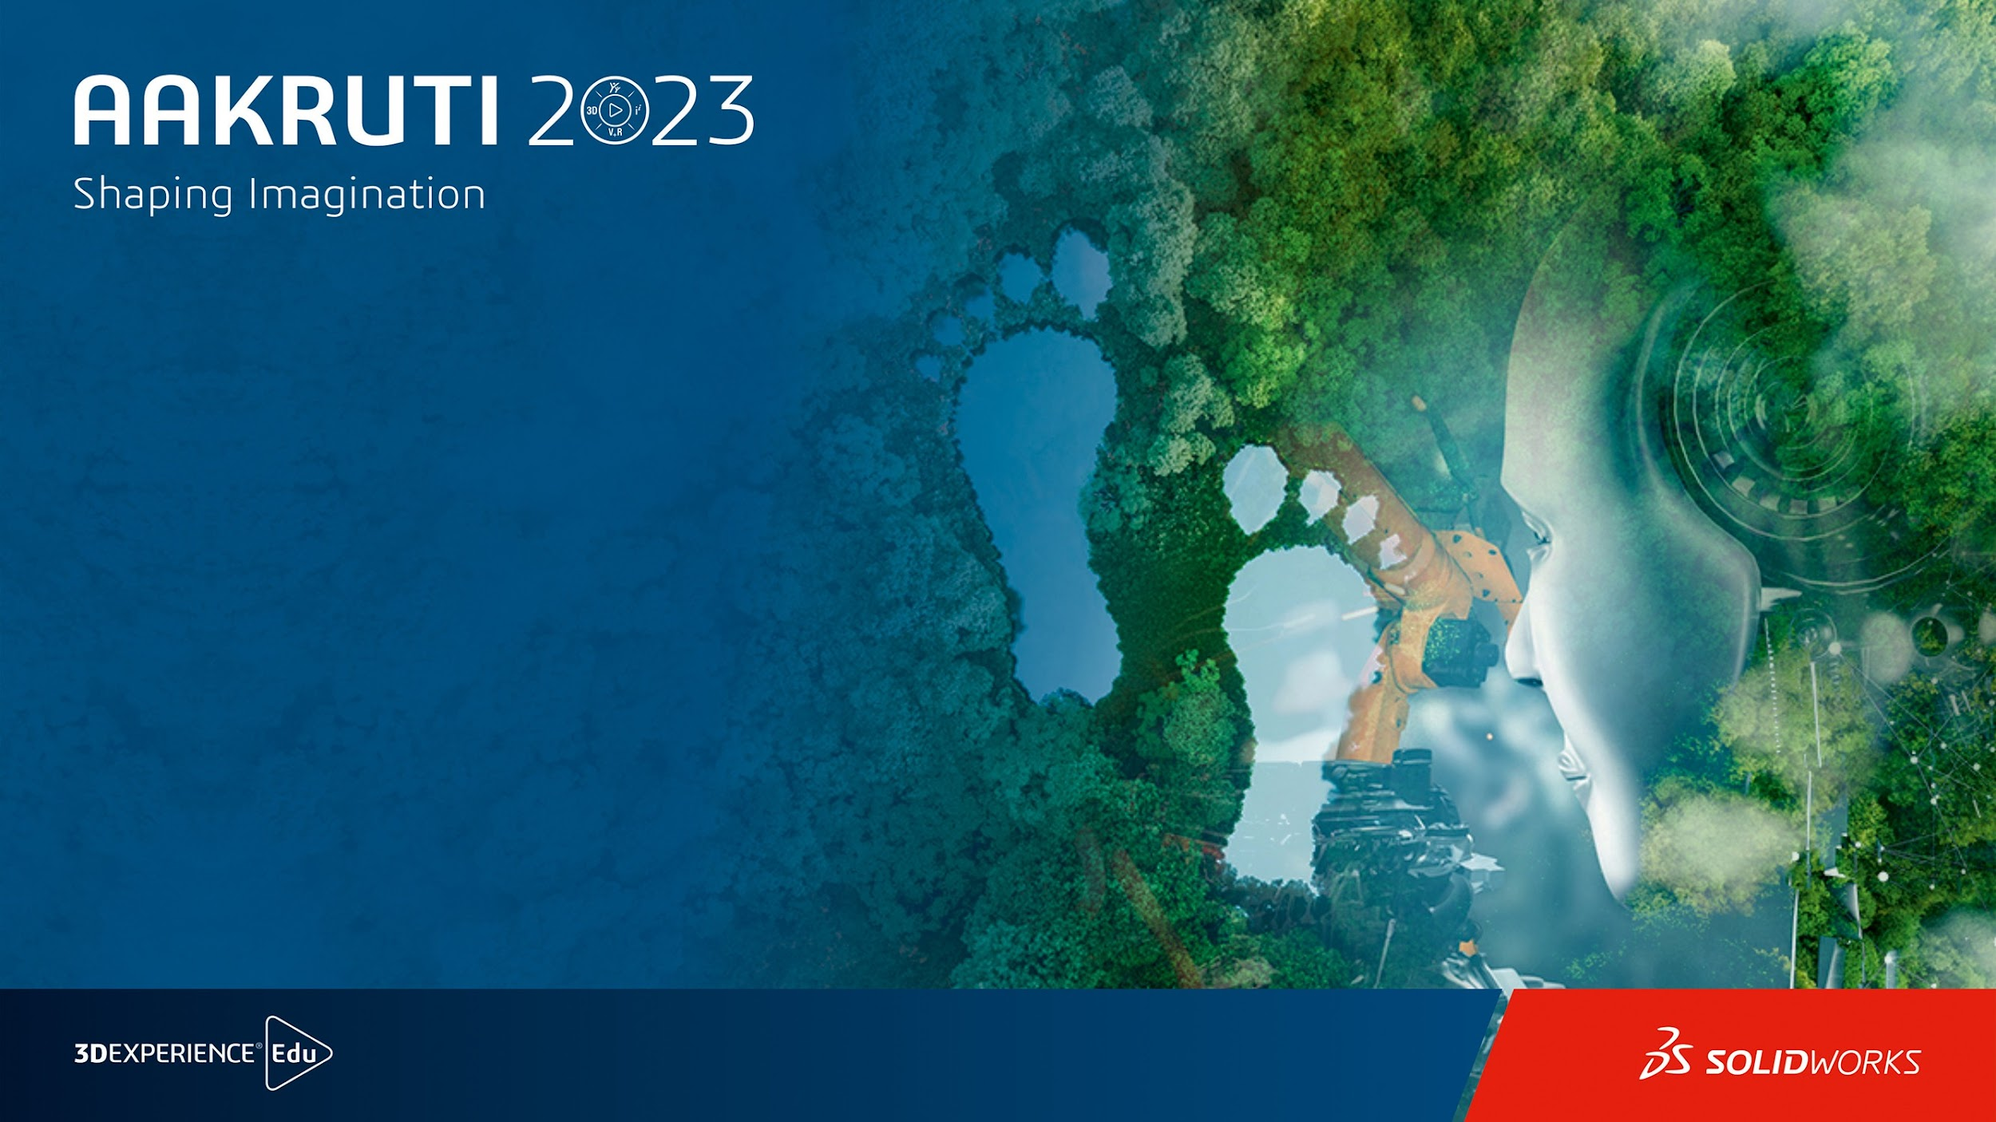
LEV-AUTO
Theme: SUSTAINABLE MOBILITY
Team Name: ARCTURUS
Team ID: A223-71012
Final design Submission

Slide 2




Team Name
Name : TANU SHRI L
Title :Overall Co-ordinator and Documentation
tanushri.mc21@bitsathy.ac.in
Name : SRIHARISH J
Title : Part Designing and Assembling
sriharish.mc21@bitsathy.ac.in
Name : HRITHIK J R
Title : Idea Generator and Part Designing
hrithik.mc21@bitsathy.ac.in
Name : VIGNESH RAM R
Title :Surface Modeling and Sketching
vigneshram.mc21@bitsathy.ac.in

Slide 3
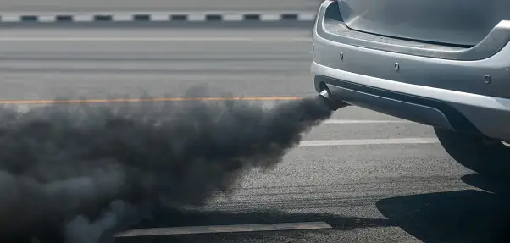
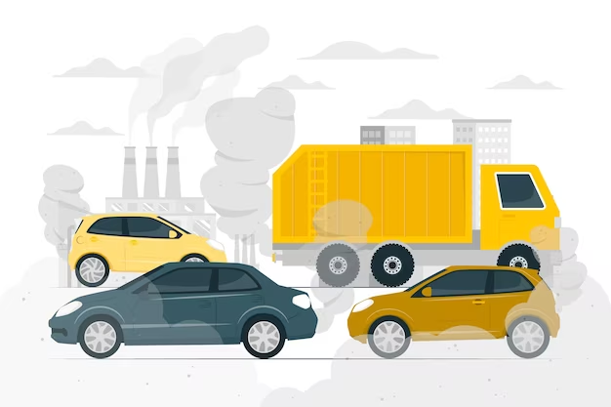
Problem Identified
PROBLEM DESCRIPTION
The proliferation of pollution from vehicles is a pressing environmental and public health concern.
Despite advancements in vehicle technology, the continued use of fossil fuels, inefficient transportation systems, and the rapid increase in the number of vehicles on the road have resulted in a significant and detrimental impact on air quality, human health, and the overall well-being of our planet.
Background:
The widespread adoption of internal combustion engines running on fossil fuels, such as gasoline and diesel, significantly contributed to the escalation of vehicular emissions. As urbanization intensified, traffic congestion and longer commutes exacerbated pollution levels, leading to concerns about deteriorating air quality and public health impacts.
Existing solution:
The electric vehicles are the alternative solution, which is still not effective as of now.

Slide 4
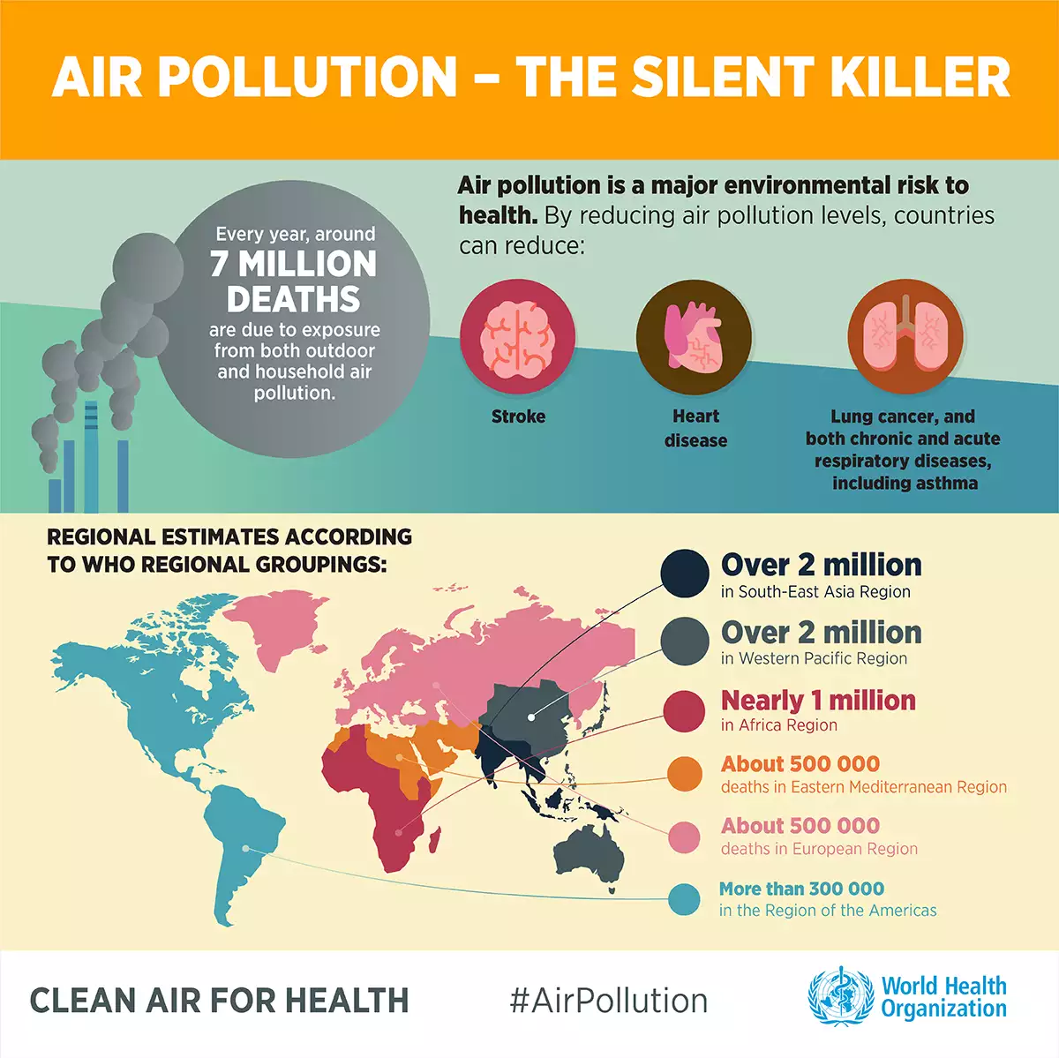
Significance
Health Impacts: Vehicle pollution harms public health, causing respiratory and cardiovascular diseases, increased healthcare costs, and premature deaths, with vulnerable populations at greater risk.
Economic Costs: Society bears financial burdens due to pollution-related healthcare expenses, infrastructure damage, and reduced agricultural productivity.
Environmental Damage: Vehicle emissions contribute to acid rain, harm ecosystems, and accelerate climate change through greenhouse gas emissions, affecting weather patterns and sea levels.
Social Inequity: Marginalized communities suffer disproportionately from vehicle pollution, leading to health disparities and reduced quality of life, while traffic congestion and stress affect individuals across society.

Slide 5
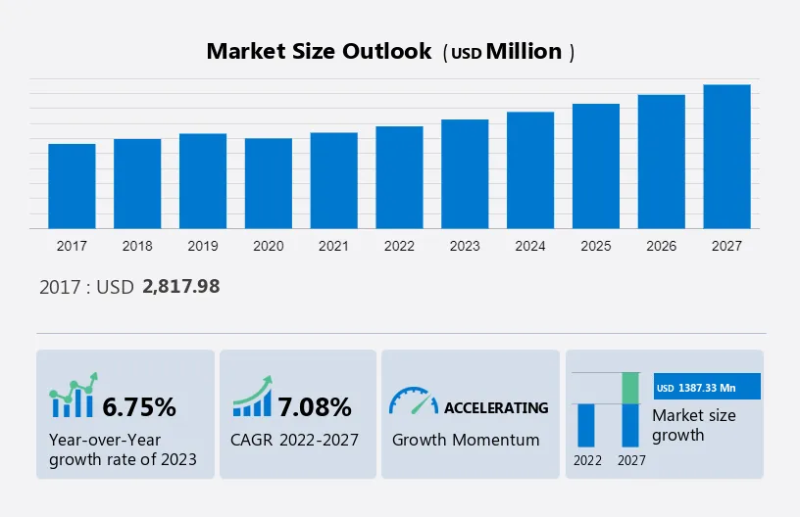
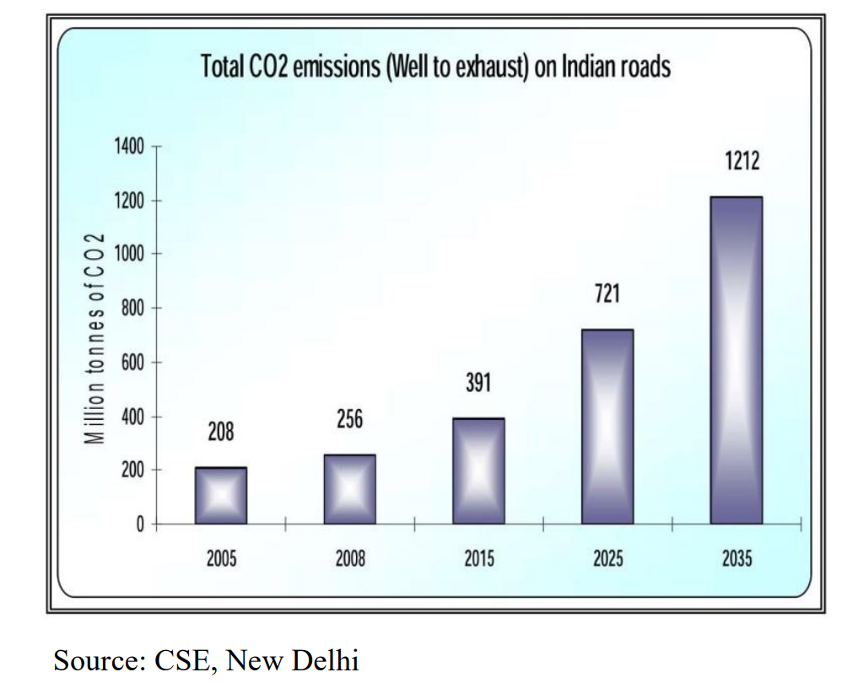
Research findings
This includes correct market survey of the magnetic levitation vehicles.
This survey depicts the overall pollution (Carbon-dioxide) of automobiles in major parts of India.
For the growth of our project, this is a crucial component.

Slide 6
User Persona - TANU SHRI L
PROFILE & DEMOGRAPHICS
ATTITUDES & MOTIVATION
Job Title: STUDENT
Gender: FEMALE
Family and Social Setting: NUCLEAR FAMILY OF 4
Income: NIL
Education: BE (MECHATRONICS)
Attitudes: Self - motivation
Beliefs: Teamwork and Collaboration
Motivations: Consistency
TASKS
PAIN POINTS
FEELINGS
Activities: CAD DESIGNING
Resources available: SOLIDWORKS
Fears: Conflict
Frustrations: NIL
Challenges: Tight Deadlines
Worries: nil
Influences: nil

Slide 7
User Persona - SRIHARISH J
PROFILE & DEMOGRAPHICS
ATTITUDES & MOTIVATION
Job Title: STUDENT
Gender: MALE
Family and Social Setting: NUCLEAR FAMILY
Income: NIL
Education: BE (MECHATRONICS)
Attitudes: Commitment, loyalty
Beliefs: Teamwork, Collaboration, Hard work and Smart work
Motivations: Independent,volunteered
TASKS
PAIN POINTS
FEELINGS
Activities: NIL
Resources available: NIL
Fears: loneliness
Frustrations: NIL
Challenges: NIL
Worries: Introvert
Influences: NIL

Slide 8
User Persona - HRITHIK J R
PROFILE & DEMOGRAPHICS
ATTITUDES & MOTIVATION
Job Title: STUDENT
Gender: MALE
Family and Social Setting: NUCLEAR FAMILY
Income: NIL
Education: BE (MECHATRONICS)
Attitudes: Commitment, loyalty
Beliefs: Teamwork
Motivations: Ambitious
TASKS
PAIN POINTS
FEELINGS
Activities: NIL
Resources available: NIL
Fears: NIL
Frustrations: NIL
Challenges: NIL
Worries: Lack of remembrance
Influences: NIL

Slide 9
User Persona - VIGNESHRAM R
PROFILE & DEMOGRAPHICS
ATTITUDES & MOTIVATION
Job Title: STUDENT
Gender: MALE
Family and Social Setting:
Income: NIL
Education: BE (MECHATRONICS)
Attitudes: Self directed
Beliefs: Team work
Motivations: Solidarity
PAIN POINTS
FEELINGS
TASKS
Fears: nil
Frustrations: Complex datasheets Challenges:Time management
Activities: Designing
Resources available: nil
Worries: nil
Influences: Tenacious

Slide 10
Product specifications
COOLING SYSTEMS :
For cooling system, we employed nitrogen and hydrogen.Since nitrogen is chemically inert, it may be utilised as a cryogenic coolant, particularly in applications requiring extremely low temperatures. We combined nitrogen and hydrogen for the cooling system. Since it has a very high thermal conductivity for hydrogen, it may effectively transfer heat away from a system. It is frequently employed in cooling superconducting materials.
MAGNETS :
We choose aluminium because it can manage eddy currents, function as magnetic shielding, offer structural support, and most importantly, it can conduct at -273 kelvin temperatures.
TRAVELLING SPEED :
Our vehicle is known for their high speeds, with some models capable of reaching speeds exceeding 200 miles per hour (320 kilometers per hour).

Slide 11
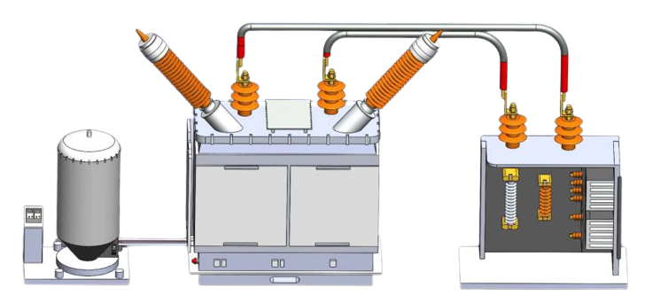
Final Solution
Innovation
Unlike other forms of transportation, this technology makes it possible to transfer goods more quickly.
Compared to cars that run on fossil fuels and 42% compared to electric cars, the emissions can be reduced by up to 80%.
Traffic congestion is decreased through particular road and vehicle construction.
This mode of transportation can save non-renewable resources the greatest.
This transportation is unique from others since, the present magnetic levitation is only used in rail transport.
We have introduced this system in goods transportation for the better advancement

Slide 12
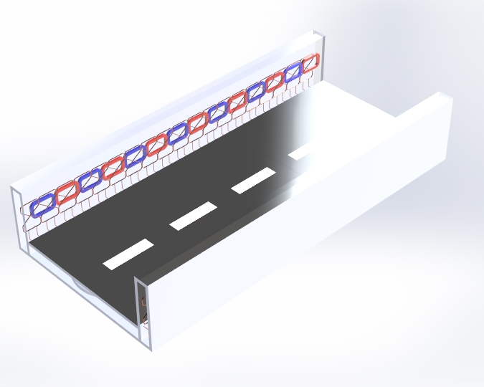
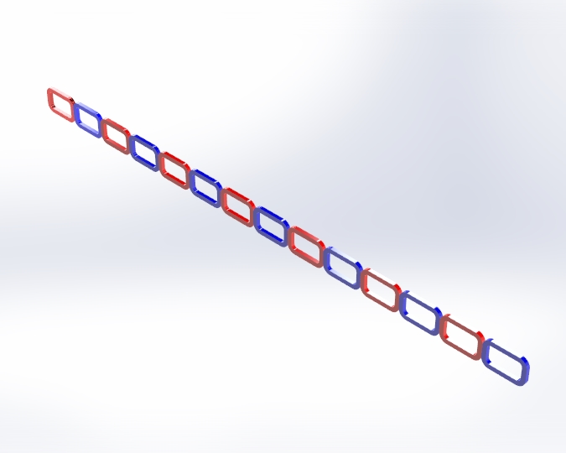
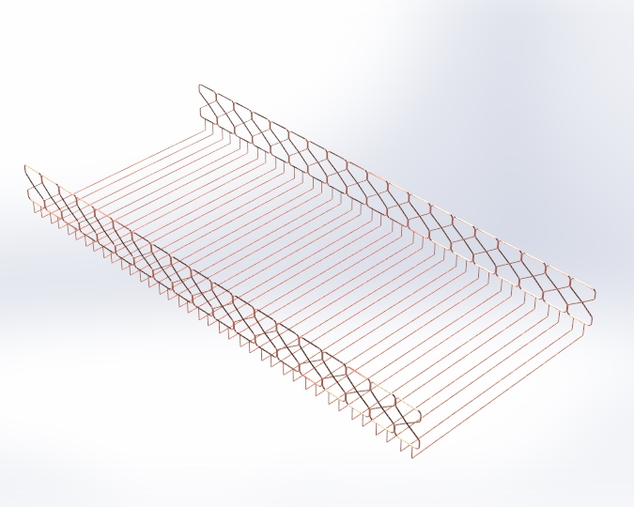
Final CAD Product Images
ROAD
MAGNETS
SUPER
CONDUCTING
COILS

Slide 13
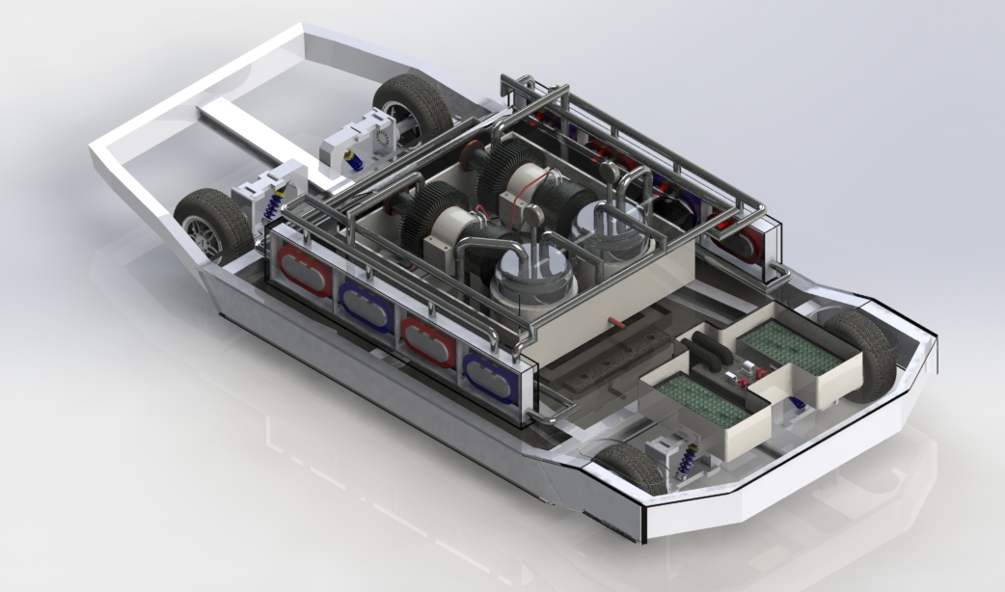
Final CAD Product Images
COMPLETE
COOLING SYSTEM
WITH CHASSIS - MAGNETIC LEVITATION

Slide 14
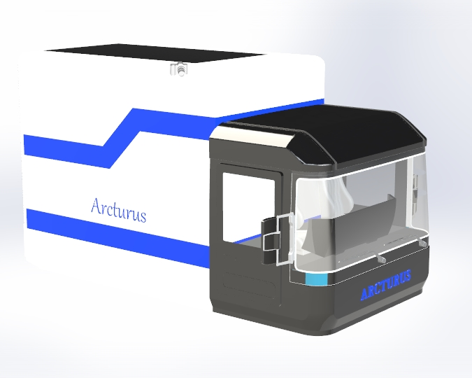
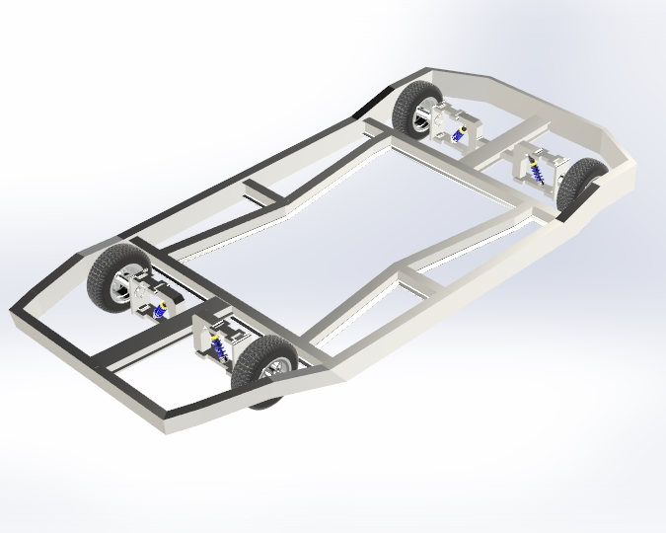
Final CAD Product Images
VEHICLE
CHASSIS

Slide 15
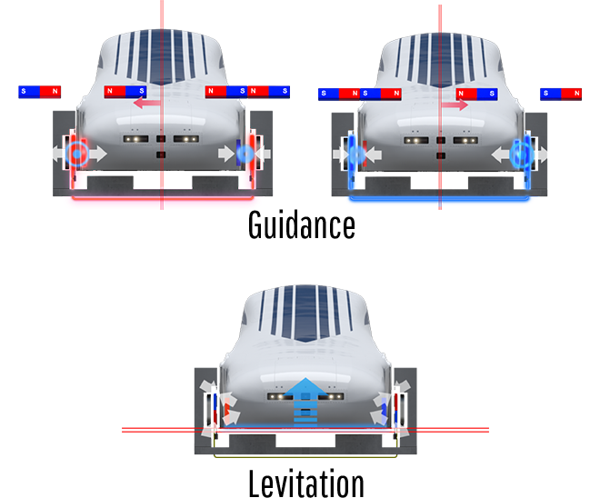
Product details
Working Principle: Electro-Magnetic Levitation using Super Conducting coils
Dedicated Tracks: The Vehicle runs on dedicated tracks that are separate from conventional rail lines and roadways. These tracks are designed specifically for high-speed trains, and they are constructed to very precise specifications. This separation minimizes interference with other modes of transportation.
Electrification: The Vehicle’s power lines are electrified, and trains are powered by inductive wireless current transmission. Electric power is more efficient and allows for quicker acceleration and deceleration compared to traditional diesel-powered trains.
High-Speed Trains: The Vehicle’s are specially designed for high-speed travel.

Slide 16
Key features include:
Emergency Systems: The vehicle is equipped with numerous safety features, including emergency brakes and systems for fire detection and suppression. These systems ensure safety and minimize the risk of accidents.
Maintenance and Inspections: Regular maintenance and inspections are crucial for the safety and reliability of truck. Specialized maintenance facilities and well-defined inspection procedures are in place to keep the vehicle in excellent condition.
Speed Control: Speed limits will be set for different sections of the track, and the vehicle onboard computers constantly monitor and adjust the speed to maintain safety. Additionally, curves on the tracks are designed to minimize lateral forces on the vehicle, allowing for smoother and safer travel at high speeds.

Slide 17
Key features include:
Lightweight Materials: The use of lightweight materials, such as aluminum, in the vehicle's construction helps reduce energy consumption and increase speed.
Specialized Bodies: The wheel assemblies (bodies) are designed to provide stability and minimize vibration at high speeds.
Automatic Train Control (ATC): This system continuously monitors the vehicle's position and speed, automatically adjusting the throttle and brakes to maintain safe distances between trains and ensure they adhere to speed limits.
Centralized Traffic Control (CTC): CTC systems enable centralized monitoring and control of the entire road network, allowing for efficient traffic management and real-time response to incidents.
Regenerative Braking: The Vehicle's use regenerative braking, which converts kinetic energy into electrical energy when slowing down or stopping. This energy is then fed back into the power grid, making the system more energy-efficient.

Slide 18
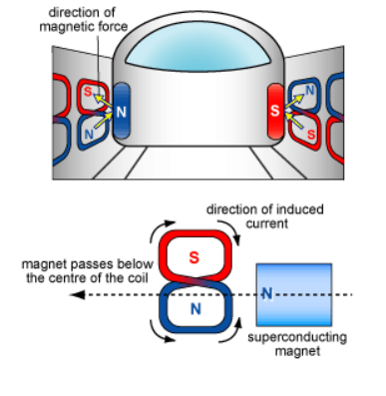
Product reflection
The advantages of using our solution will outweigh the drawbacks as possible and enable improvements in wireless charging technology.
Reduces maintenance, it operates quietly and cleanly, is scalable to fit different power levels, and lessens wear and tear, all of which are compatible with automation.
The drawbacks include heat generation, interfaces, infrastructure requirements, and lower distance power transfer efficiency.
This electromagnetic waves may affect humans if this is used for passenger, but we are using here for the goods transportation which doesn’t affect the humans.

Slide 19
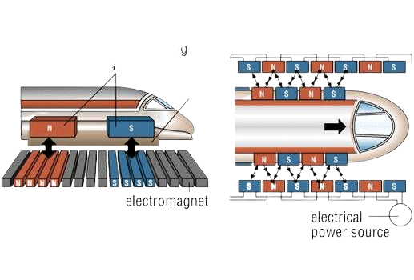
Design process
We checked the project's objectives and specifics about the SC maglev as a passenger vehicle, but there were too many issues that we were unable to handle; as a result, we shifted our design target to a goods carrier vehicle.
Following that, we conducted study on the SC Maglev's operating mechanism from journals and research papers, and we finalised the mechanism.
Weldments and sweep features were used to create the exoskeleton of the chassis before the addition of suspension components.
The vehicle's support wheels' alloy wheels and rubber tyres were then designed.
The design of the superconducting coils, which had more parts than we could possibly manufacture and included components like terminals, coil holders, and closures, is the next and most crucial phase.
Finally, the body and power source. The power source consists of a basic power grid made of two batteries. The body has both vintage and model truck aesthetics.

Slide 20
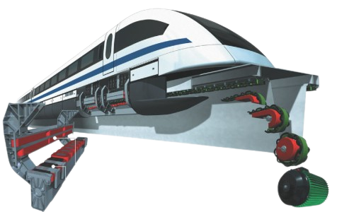
Impact of your solution
Reduced Traffic Congestion: This system can operate at high speeds and on dedicated guideways, reducing traffic congestion in urban areas.
Environmental Benefits: This system are typically more energy-efficient and produce fewer emissions compared to traditional forms of transportation.
Increased Mobility: This can provide fast and efficient transportation options for both urban and intercity travel.
Safety and Reliability: This system are known for their high safety and reliability. The absence of physical contact between the vehicle and the road reduces the risk of derailments and accidents.
Economic Growth: The construction and operation of this systems can stimulate economic growth. It creates jobs during the construction phase and can boost tourism and local economies by improving accessibility to different regions.

Slide 21
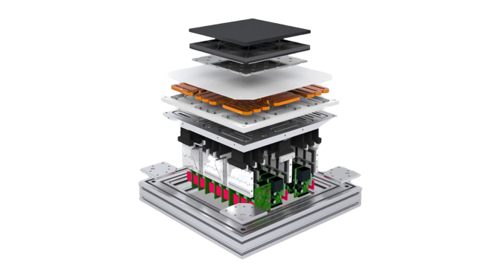
Sustainability
LOW MAINTENANCE COST
RESEARCH DEVELOPMENT FOR TECHNOLOGICAL ADVANCEMENTS
INCREASED EMPLOYMENT RATE
REDUCED LAND USE
ENERGY EFFICIENCY

Slide 22
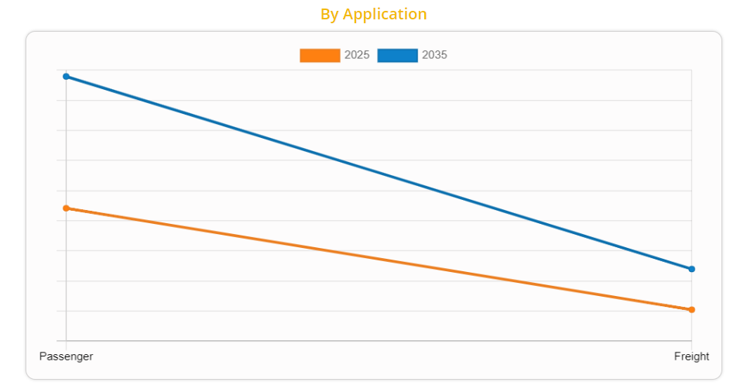
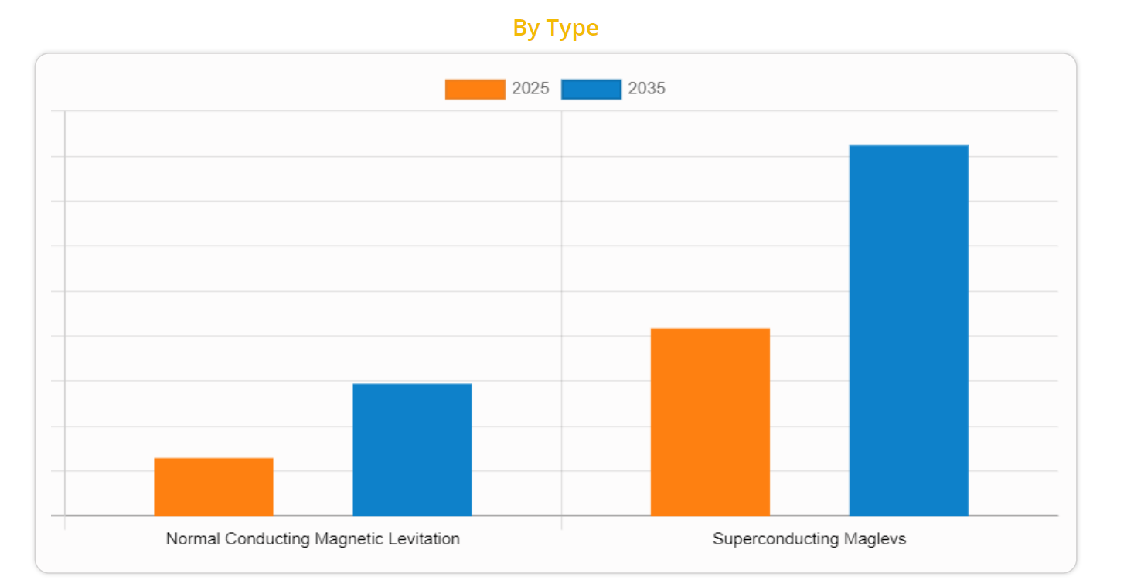
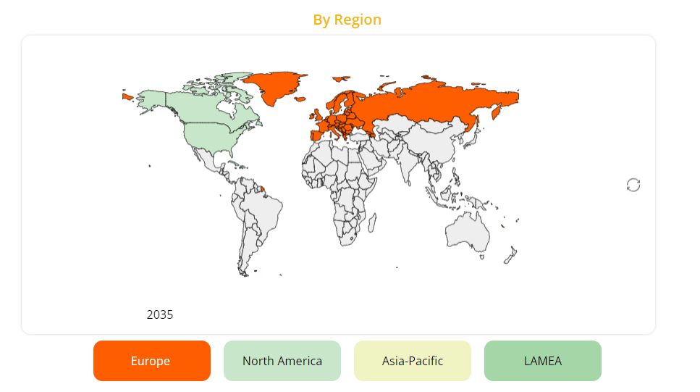
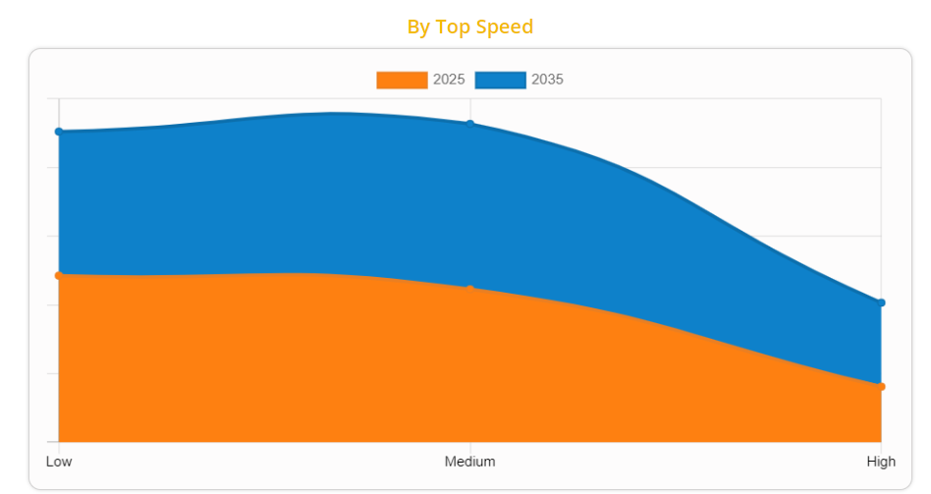
Business viability
The future market availability based on different criterias are given below:

Slide 23
Reference
Current state of magnetic levitation and its applications in polymers: A review
Superconductor and magnet levitation devices
Magnetic Levitation Systems for Cost-Sensitive Applications—Some Design Aspects
General survey of the possible applications and development tendencies of magnetic levitation technology
Applications of Magnetic Levitation Based Micro Automation in Semiconductor

Slide 24
Thank you!

